Slide 1
Project Planning for Computing Science
Dr Stephen Lindsay

Slide 2
Before we start….
Sean Walton’s talk uploaded in the lectures in CSM10 Blackboard should be considered essential viewing as an addition to this
Notes:
5

Slide 3
Learning Goals
Why do we need to do project planning?
Understanding Software Development Life Cycles and choosing the right one for your project
Planning your time using Gantt charts and understanding what makes a good Gantt Chart
Using Risk Assessments to sensibly guide your planning
Thinking, thinking, thinking
Notes:
5

Slide 4
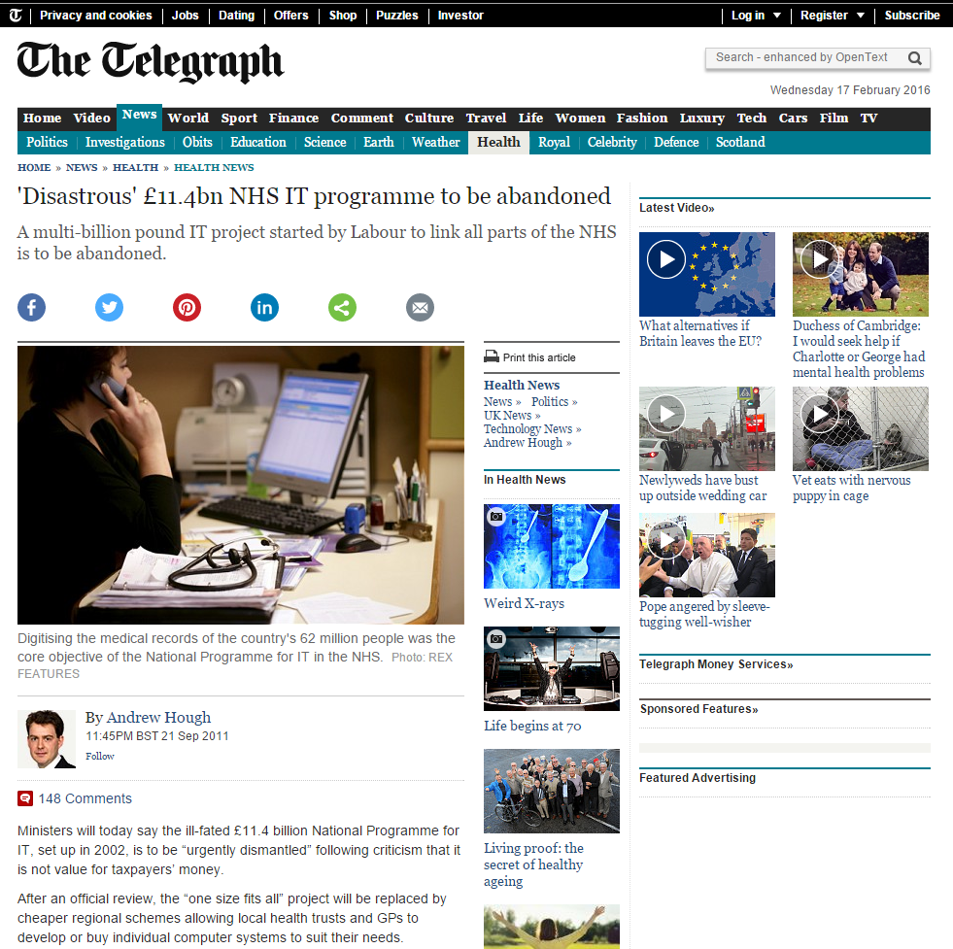
Why do we care about planning?

Slide 5
What do you know about planning?
What terms do you know about planning? What techniques can you make use of? How do you feel about planning?
Notes:
3

Slide 6
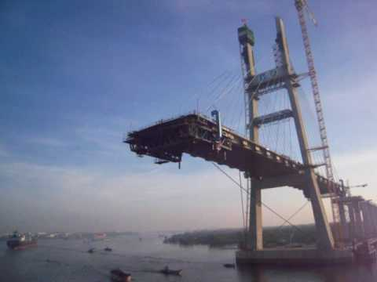
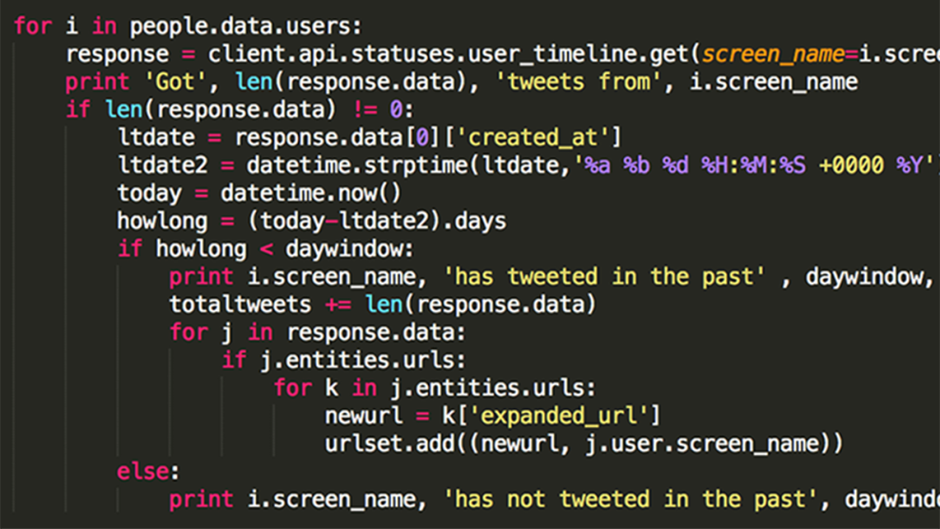
The necessity of planning
Failing to plan is the same as planning to fail
6 Ps Proper preparation and planning prevents piss-poor performance
Planning for a software development effort is particularly difficult to do because of the intangibility of the medium
Think about the difference between our discipline and civil engineering
Notes:
5

Slide 7
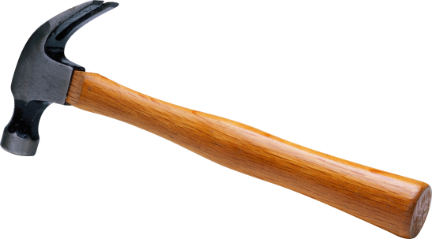

Software Development Lifecycles
Starting with what you know - you should be familiar with some SDLs already from previous work
In general, an SDL is a principle rather than a plan – it’s an idea to help you guide how you plan out your approach to development
An SDL is not a substitute for thinking about software development
If something doesn’t seem to flow properly, don’t blindly stick to a single SDL
Choosing between tools is the useful skillset here
Notes:
5

Slide 8
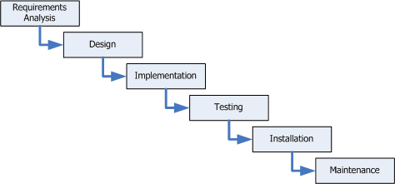
Waterfall method

Slide 9
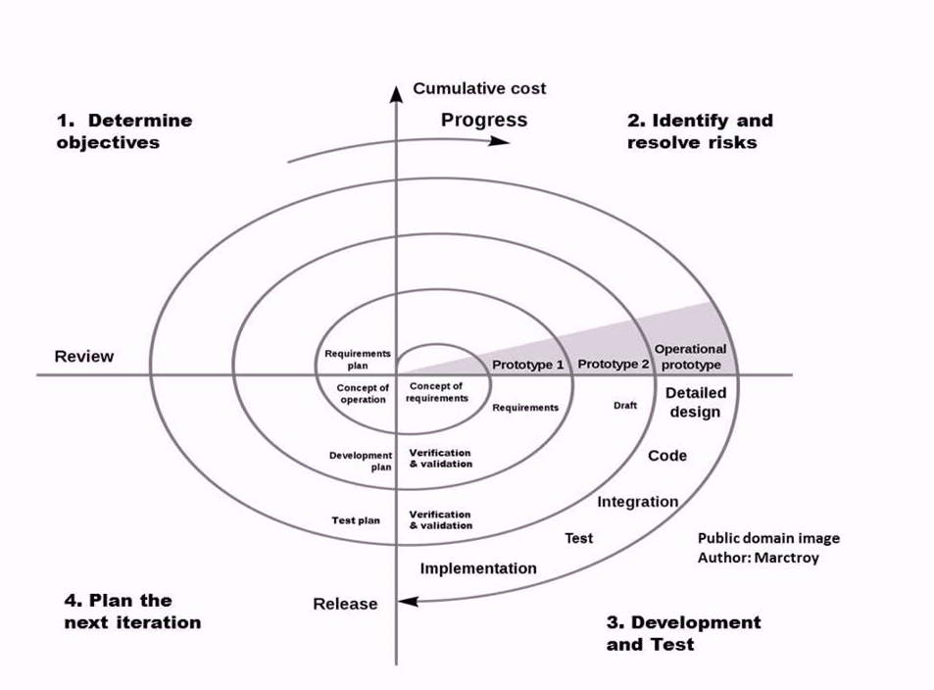
Spiral method / prototyping

Slide 10
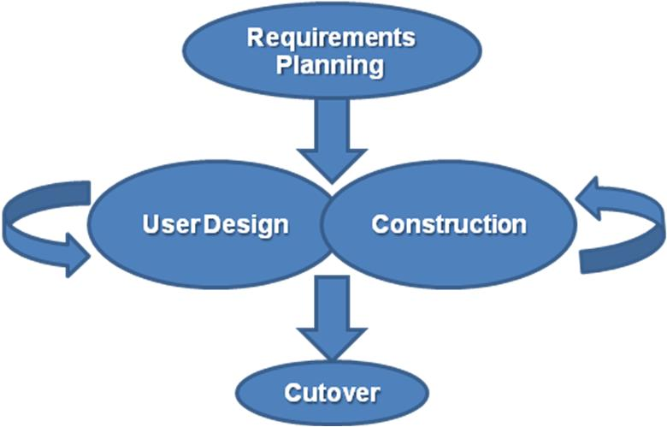
Rapid Application Development (RAD)
Notes:
Key emphasis is on fulfilling the business need, while technological or engineering excellence is of lesser importance.

Slide 11
Agile Development
Agile software development approaches are based on iterative, timeboxed development
requirements and solutions evolve via collaboration between self-organizing teams
Agile software development uses iterative development as a basis but advocates a lighter and more people-centric viewpoint than traditional approaches
Agile is a concept, not a plan! It has to be realised via specific methods
Scrum
Sprints of 1 week-1month, daily scrums 15 minutes, sprint reviews
DSDM
MoSCoW: Must, Should, Could, Wont
Kanban
Kanban boards track progress and limit work in progress, Personal Kanban book on individuals using Kanban
Notes:
5

Slide 12
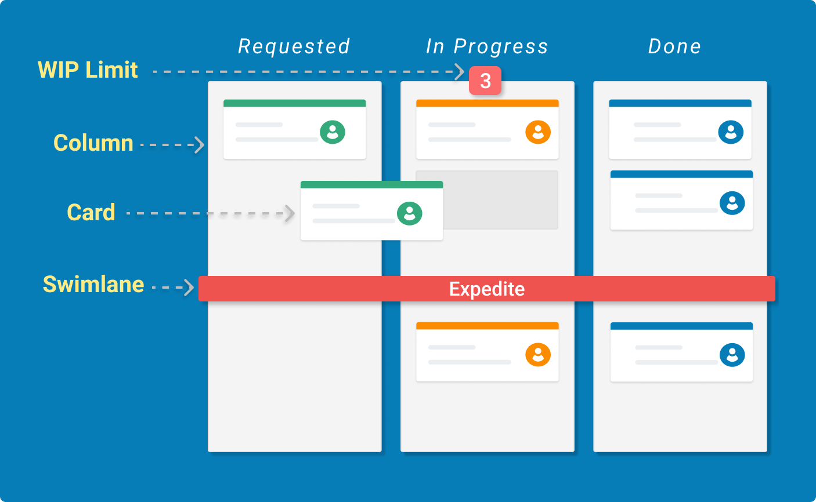
Notes:
5

Slide 13
Welsh Coast App
You’re working on a project developing an app in collaboration with a local charity to encourage people to visit and walk the Welsh Coast. The company already have an app but they want you to improve it by adding some new, interesting features to it. They don’t really know what these features should be at the moment….
Notes:
3

Slide 14
Securing the Android Platform
You are working to tackle a problem on Android platforms around the ways in which certain malicious pieces of software pass information between themselves to get it off your phone (Malicious App 1 can read contact info and access your power LED; Malicious App 2 can Access the Internet and your power LED…). You have been given a specification from an academic paper that tackles this and been challenged to implement it.
Notes:
3

Slide 15
MEng Project
You are working as part of a team of project students in collaboration with a business to implement a new website for them with several distinct features on it such as the ability to view and customise products, the ability to chat with an advisor about the products and the ability to register to get a visit from the companies sale team.
Notes:
3

Slide 16
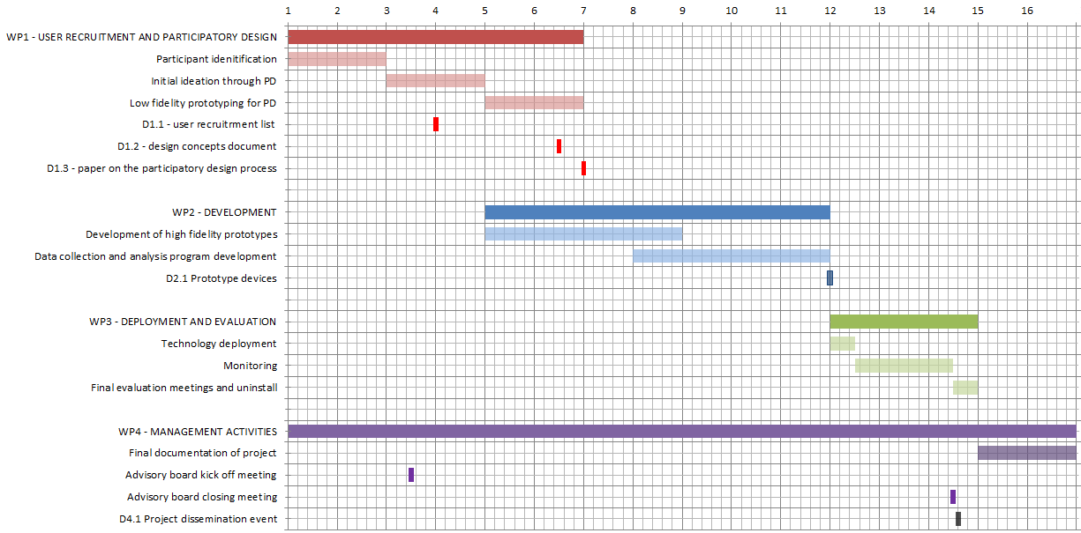
Gantt Charts

Slide 18
Gantt Charts
Gantt charts illustrate the start and finish dates of the terminal elements and summary elements of a project
Modern Gantt charts also show the dependency relationships between activities
Where does one piece of work have to be finished before another can start
Great for resource allocation issues – catches times where a software development team needs to work on 3 things at the same time but you only employ 2 software developers!
Gantt charts can be used to show current schedule status using percent-complete shadings and a vertical "TODAY" line

Slide 19
Gantt Charts – make them useful
A Gantt chart is something you should be able to take into meetings with your supervisor and refer to every 1-2 weeks
That should give a clear hint about how much detail you need to work into them
Include deliverables but ask yourself - do they need to take up entire weeks?
Be realistic when making them! If you don’t have enough time, don’t fiddle with the Gantt chart!!!
Tie your Gantt chart to your SDLC and your Risk Assessment
If you are doing the spiral approach with prototypes, show your prototypes
If you are working on an Agile method, show the sprints you will employ

Slide 20
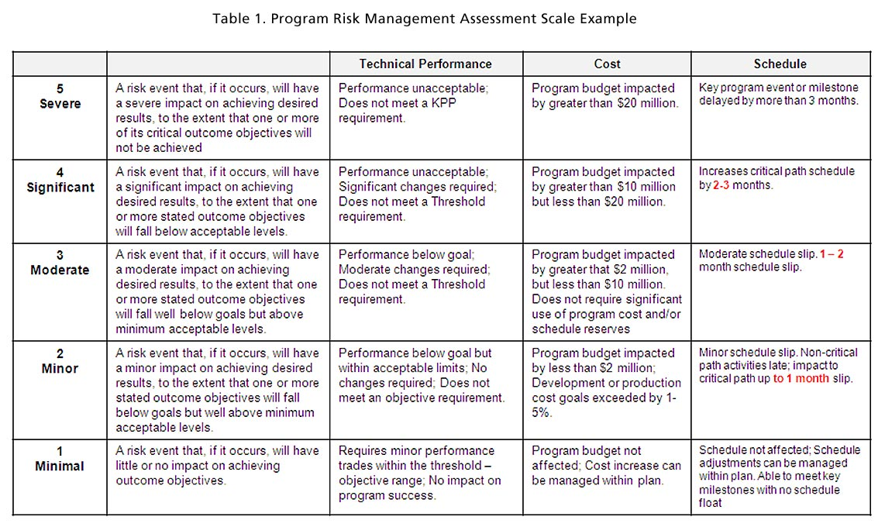
Risk Assessment Tables

Slide 21
Risk Assessment
Risk Assessment is thinking:
What can go wrong?
How likely is it to go wrong?
How bad is it if it goes wrong?
Once you know this, you need to think about two responses
Mitigation – how can I make this less likely to happen
Management – if it happens, how will I deal with it
Make them useful!
Generics are not really helpful as they often have no management- I might get ill, my laptop might break, my dog might eat the software
What can uniquely go wrong with this project and how do you manage it?

Slide 22
Summary
You will need to chose an appropriate SDLC for your project – the trick is in choosing the right one and that will require some reading and thinking on your part
You must produce a Gantt chart to track your work and to understand if your project is feasible
Risk assessment is not a dry, useless exercise, it is about finding the solution to serious problems before they happen and ruin your whole week!

Slide 23
Ethics In Computing Science and research
Dr Stephen Lindsay

Slide 24
Why do we care about ethics?
In groups of 4, try to come up with as many reasons as possible for being attentive to ethical issues in research
Notes:
3

Slide 25
Why should we care about research ethics?
Ethical or moral reasons:
We don’t want to harm people
We want our work to have a net positive benefit
Practical and pragmatic reasons
We don’t want to get sued
We want to be insured if something goes wrong
We want to publish or submit our work and need a “rubber stamp”
We want to be able to carry on doing science in the long run
Competence reasons
We want to be sure that we haven’t missed something in our reasoning about a research area
Notes:
5

Slide 26
The ACM Code of Ethics
Avoid harm to others
Be honest/trustworthy/non-discriminatory
Raise awareness of computing in society
Honour copyright/patent agreements
Notes:
7
But human experiments go much further than this

Slide 27
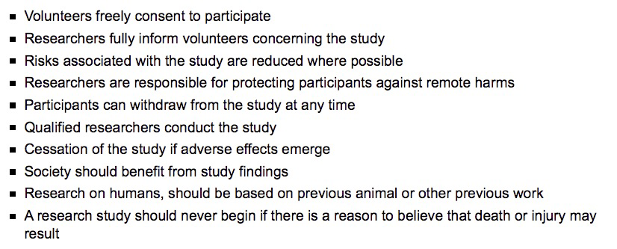
Historical Perspective - the Nuremberg Code
Generated by a tribunal focussing on the inappropriate studies performed by Nazi physicians
Too awful to go into but it would be a mistake to think that the revelations solved everything
Notes:
9
A convenient approach to “What not to do”
TRAN: why is this so important

Slide 28
Milgram’s obedience study (1963)
Told participants that they were taking the role as a teacher to study how punishments effect learning
If the ‘learner’ got a question wrong, participants had to administer an electric shock (they got increasingly worse)
Fake answers and fake cries of pain were played back
Participants continued to do as told by experimenter well beyond seemingly ‘safe’ levels of shocks
The ‘learner’ eventually stopped responding, but still they administered shocks
“Participants suffered extreme stress, and even suffered seizures.”
Notes:
14
Famous study that you may well have heard of

Slide 29
Historical abuses in research
The Monster Study
Speech therapy intervention applied with orphaned students
MKULTRA
US military research into the possibilities of telepathy and mind control (!)
Drugs such as LSD administered without consent resulting in some deaths
The Tuskegee experiments
Black men deliberately left untreated for syphilis for an extended period of time
Notes:
18
Famous study that you may well have heard of

Slide 30
Historical abuses in research
The Monster Study (1939)
Speech therapy intervention applied with orphaned students
MKULTRA (1973)
US military research into the possibilities of telepathy and mind control (!)
Drugs such as LSD administered without consent resulting in some deaths
Agent Orange experiments (1973)
“Defoliant” used in Vietnam war
But also experimented on prisoners extensively
The Tuskegee experiments (1979)
Black men deliberately left untreated for syphilis for an extended period of time
Notes:
22
Might notice something about all of these experiments…

Slide 31
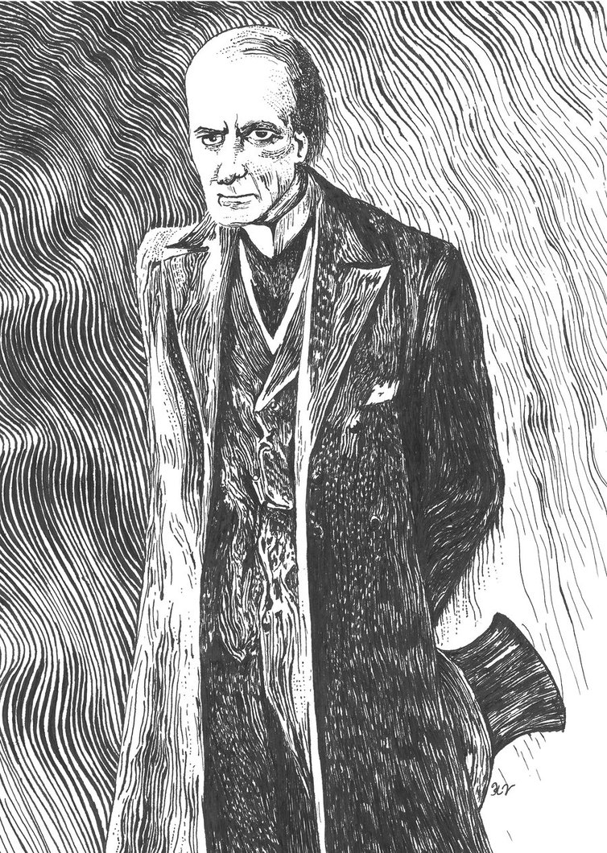
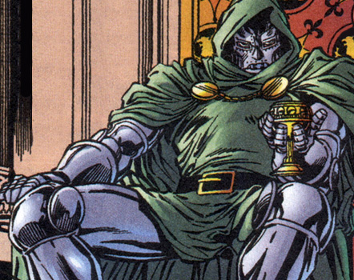

Perspectives on science

Slide 32
Perspectives on science
Science actually has something of an image problem up to the 1970s
Man meddling with things he shouldn’t or using science for selfish gains
And it’s not completely undeserved either!
More robust ethical approaches are needed to shut down these problems
The process of ethical approval being gained prior to research rises in prominence and with it, the ethics committee
Notes:
24

Slide 33
Swansea Research Student Handbook
Integrity
Openness about your research with other institutions
Data, samples, equipment should be carefully planned and stored securely (and disposed of carefully)
Research involving human participants requires approval
Disseminate results of interest professionally
Maintain reasonable intellectual property
Notes:
You’ve actually already signed up to this

Slide 34
Swansea Research Student Handbook
Integrity
Openness about your research with other institutions
Data, samples, equipment should be carefully planned and stored securely (and disposed of carefully)
Research involving human participants requires approval
Disseminate results of interest professionally
Maintain reasonable intellectual property
Notes:
26
You’ve actually already signed up to this

Slide 35
Swansea Computer Science Ethics Applications
All students need to complete an ethical assessment of their project
Discuss the process with your supervisor
When you are planning to widely publicise your work you should get approval form the committee, otherwise, your supervisor can usually approve but you must still complete the application forms
Find the forms on the College Intranet
Notes:
27

Slide 36
The Application Process
Submitting applications
Submissions go to your supervisor after you hit submit
Response Time
Allow a minimum of 7 days, responses are not guaranteed in this time frame
Pilot studies
Still require ethical approval
Re-application
If the experiment changes, you need to re-apply for approval
Notes:
32

Slide 37
Informed Consent
Informed consent is critical in ethical research and means that a participant understands what they are going to be subjected to
Issues arise when you need to “mislead” a participant if you are worried about Placebo
Issues arise over capacity to consent if working with the young or cognitively impaired
Notes:
34

Slide 38
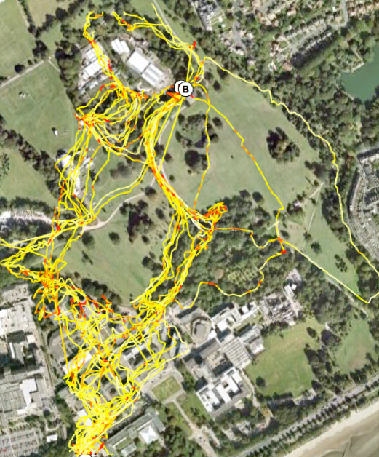
Participant Safety
More than common sense needs to be applied when thinking in this space!
Go overboard trying to identify risks and addressing them in your study protocol
People think they have to do what you ask them, despite risk/damage to themselves (remember Milgram’s study)
How do you mediate such behaviour?
Notes:
38

Slide 39
Participant anonymity
Why do you ensure participant anonymity?
How do you ensure that your participant’s identity is kept anonymous?
Notes:
42

Slide 40
Participant anonymity
Remove personally identifying information
But what is personally identifying information?
Consider how you use the data
Qualitative vs quantitative analysis
Think about requirements under the data protection act
Notes:
44

Slide 41
Some cases to think about
There is often no black/white clear yes/no in this space
There is nearly always a way that research questions can be studied
Its a matter of thinking about the ethics and making sure your methods are ok.

Slide 42
Medical Histories
What are the issues working with these?
Notes:
What % of comp sci graduates does this effect?
When i was first taught this stuff I rolled my eyes ( 10 years ago)

Slide 43
Medical Histories
In this case, it does not involve working directly with real people
However, the study incurs serious data protection issues
How anonymous can the data be?
Information can be private/embarrassing to people
What happens if this data is lost/stolen?
Notes:
When i was first taught this stuff I rolled my eyes ( 10 years ago)

Slide 44
In-car technologies
An MSc student wanted to study use of audio feedback to control speeding
We can’t suggest/organise people speeding
We can’t suggest people make their judgements based on under-developed technology
Lots of meta-method research into simulated driving studies

Slide 45
In-home electrical usage monitor
Studying energy consumption
Asking participants to play with live-wire electronics puts them at potential risk
What if our technology damages their property?
What if our technology damages them?

Slide 46
Mood+Tech
An MRes has studied how people’s mood might affect their walking
Can we detect that with technology and help change people’s mood?
An anonymous paper put people into certain moods and studied their performance with behaviour
To get people sad, they played a movie scene about a patient dying from cancer
Is that OK? How can we minimise risk here?

Slide 47
What issues are there with this?
“When designing technology for care homes looking after people living with cognitive impairment we found it best to solely talk to caregivers as the ethics process was clearer”
Notes:
Orpwood example to
Not my statement, what’s the problem with saying this?

Slide 48
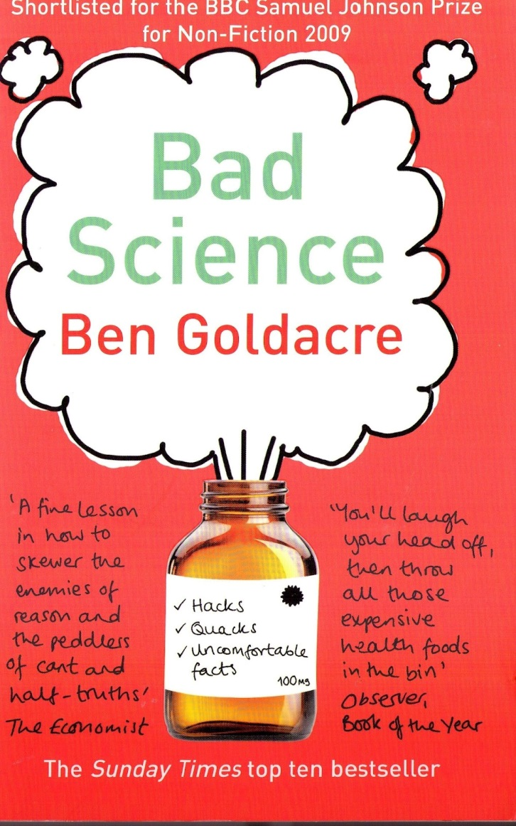
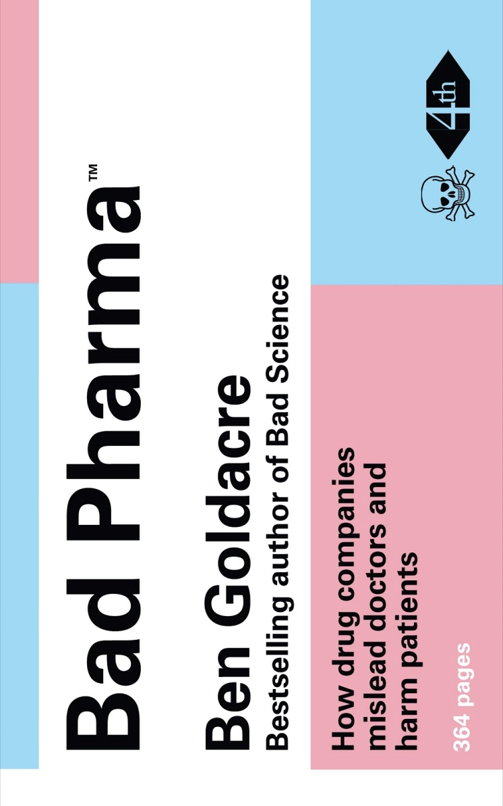
Further reading

